Slide 1
Challenging students to develop technical and employability skills as they engineer solutions to problems that impact us all
Jill Zande
President/Executive Director
MATE Inspiration for Innovation
Chair, Marine Technology Society-Monterey Section jzande@marinetech.org
www.materovcompetition.org

Slide 2
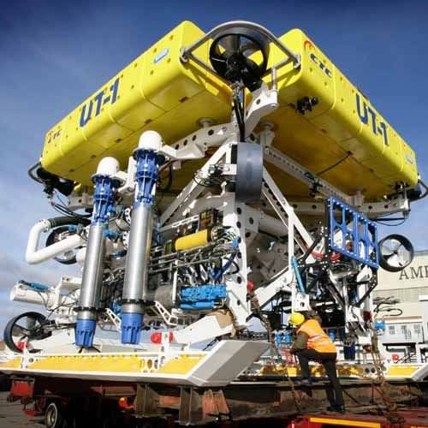
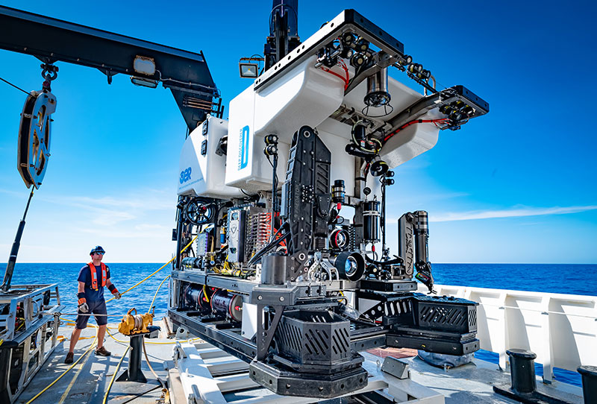
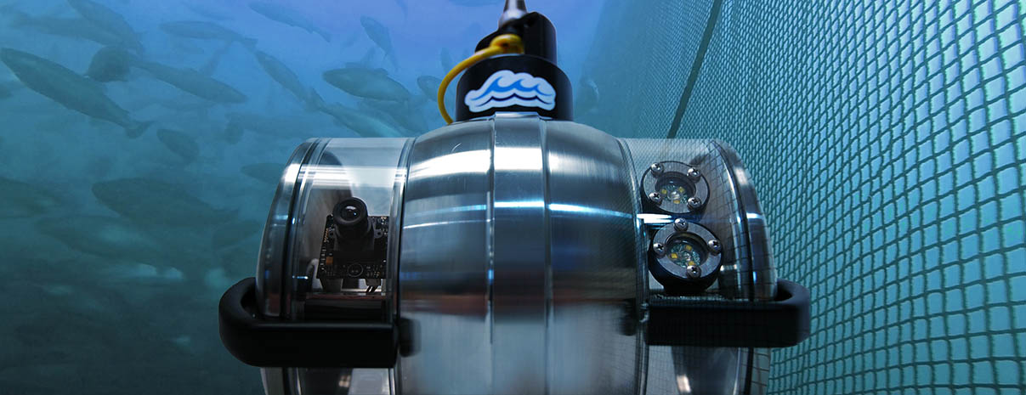
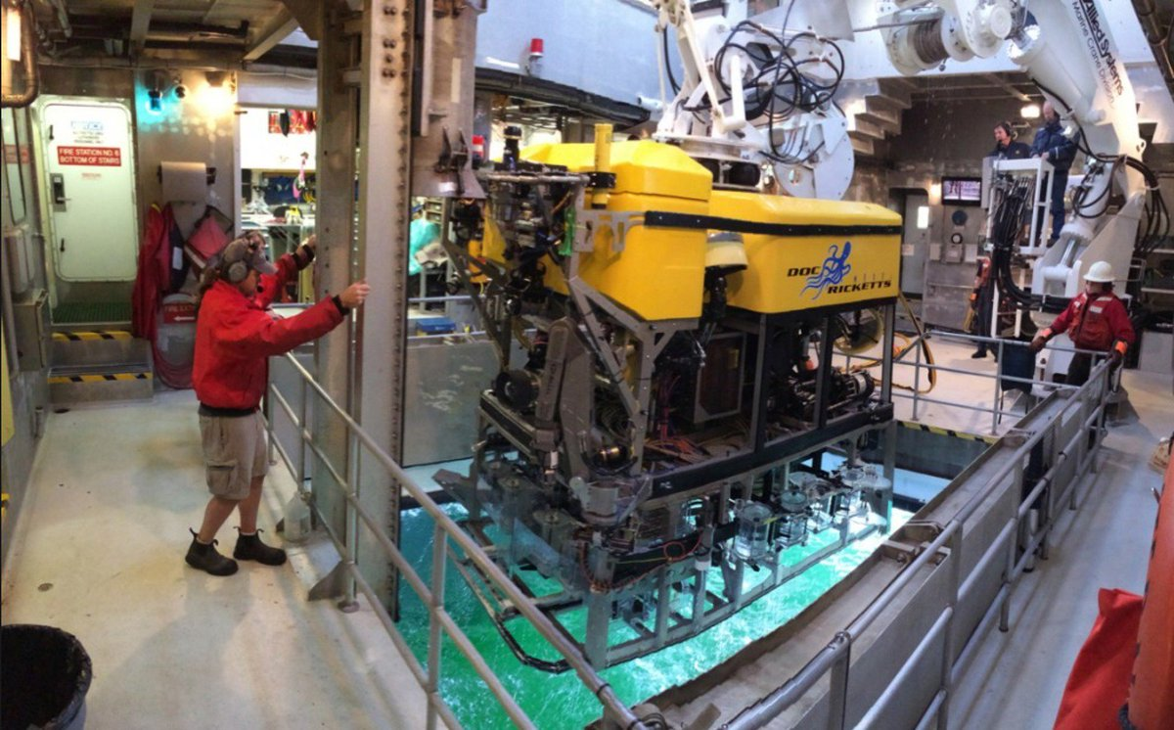
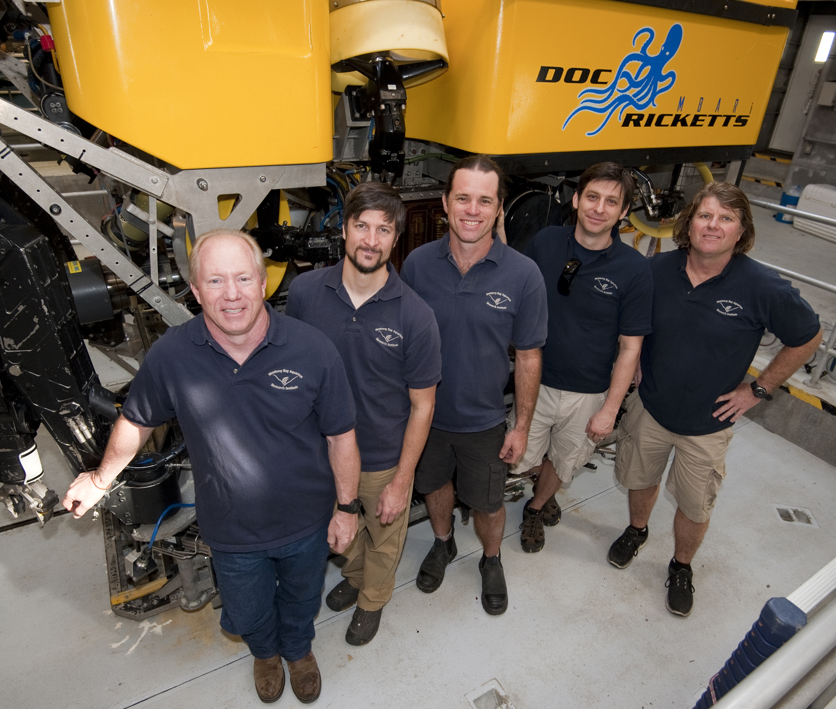
WHAT IS AN ROV?
Remotely Operated Vehicle
(aka underwater robot)
ROVs are used in a variety of fields:
Offshore energy
Telecommunications
Homeland security and defense
Search and recovery
Construction and inspection
Underwater archaeology
Aquaculture
Science and exploration
STEM education

Slide 3
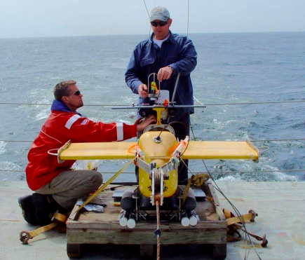
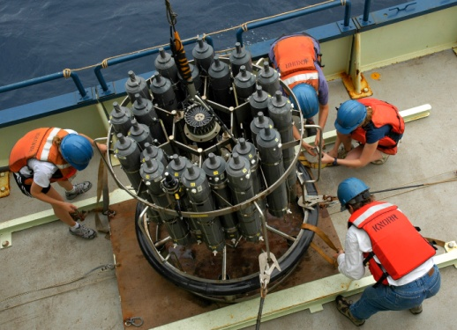
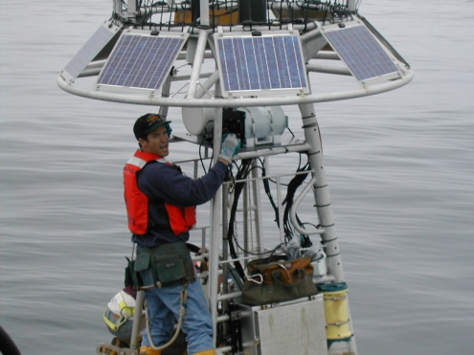
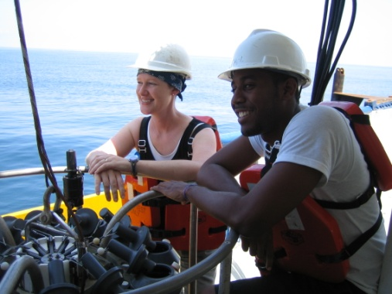
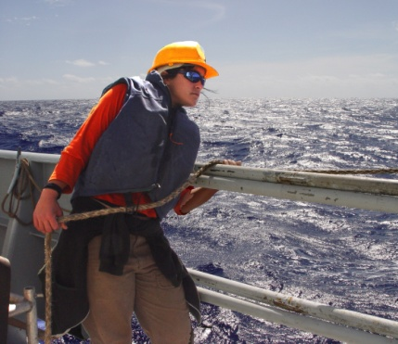
IN THE BEGINNING…
The Marine Advanced Technology Education (MATE) Center
Established with funding from the National Science Foundation in 1997 via a grant to Monterey Peninsula College.
MATE’s mission is to inspire and challenge students to learn and creatively apply STEM skills to solving real-world problems in a way that strengthens their critical thinking, collaboration, entrepreneurship, and innovation.
A hallmark of MATE’s programs, products, and services is that they are aligned with ocean workforce research and trends.

Slide 4
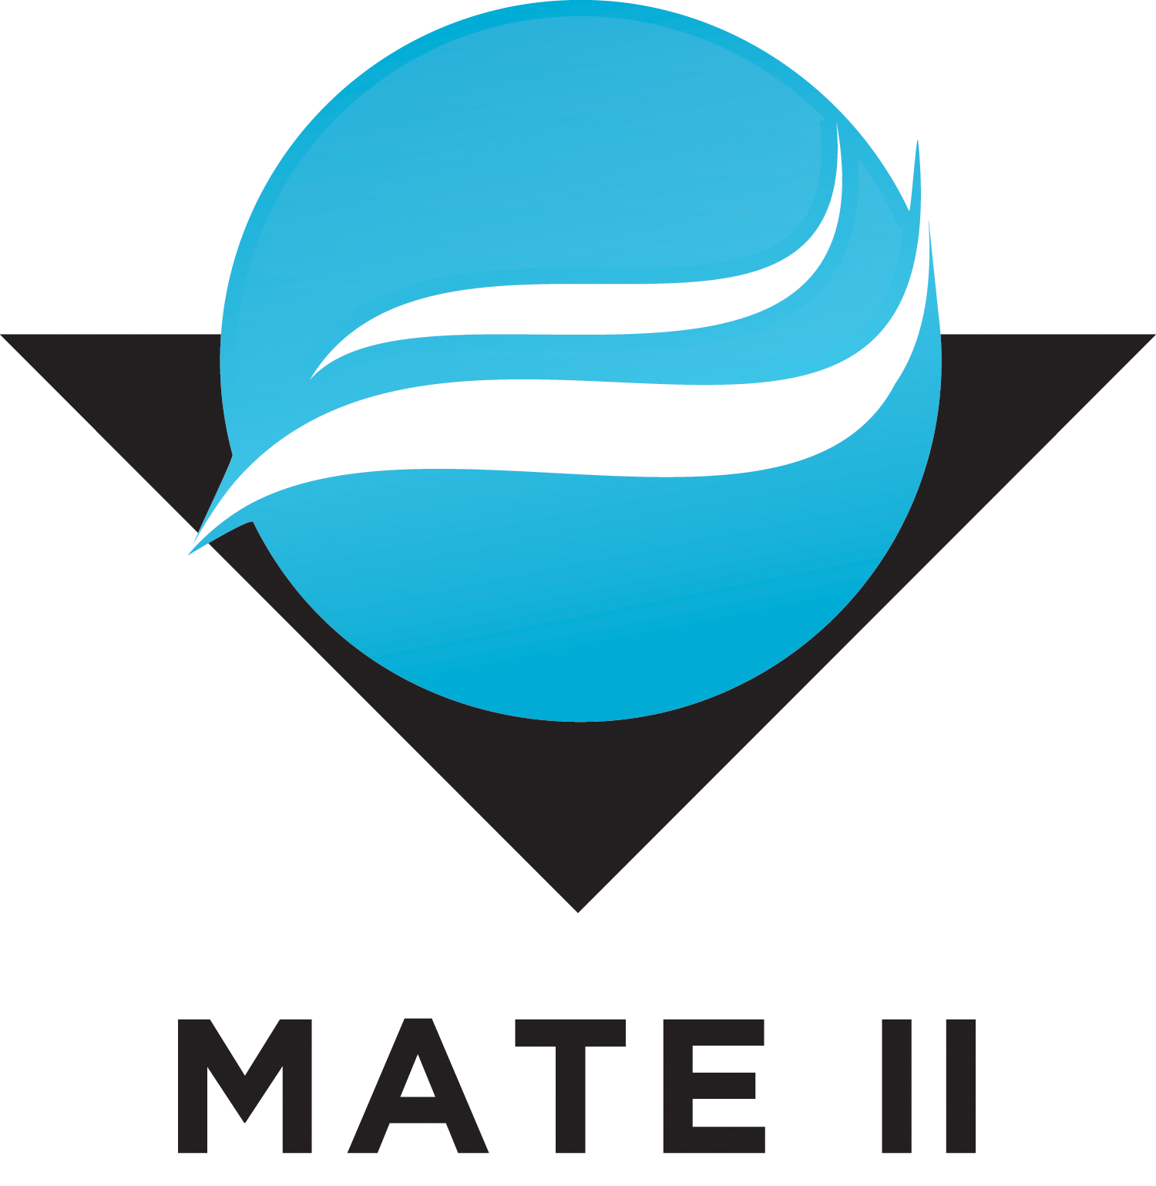
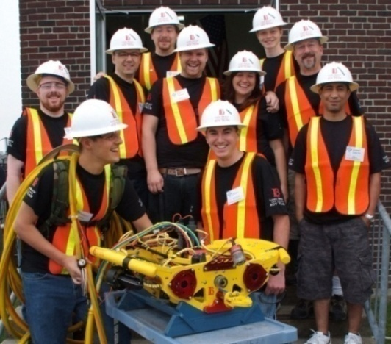
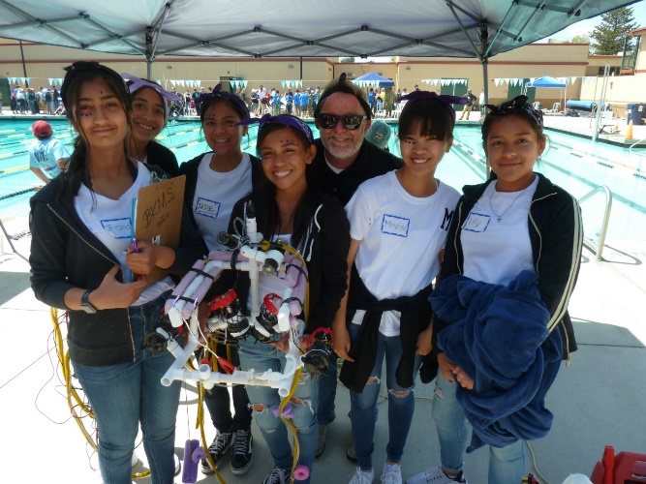
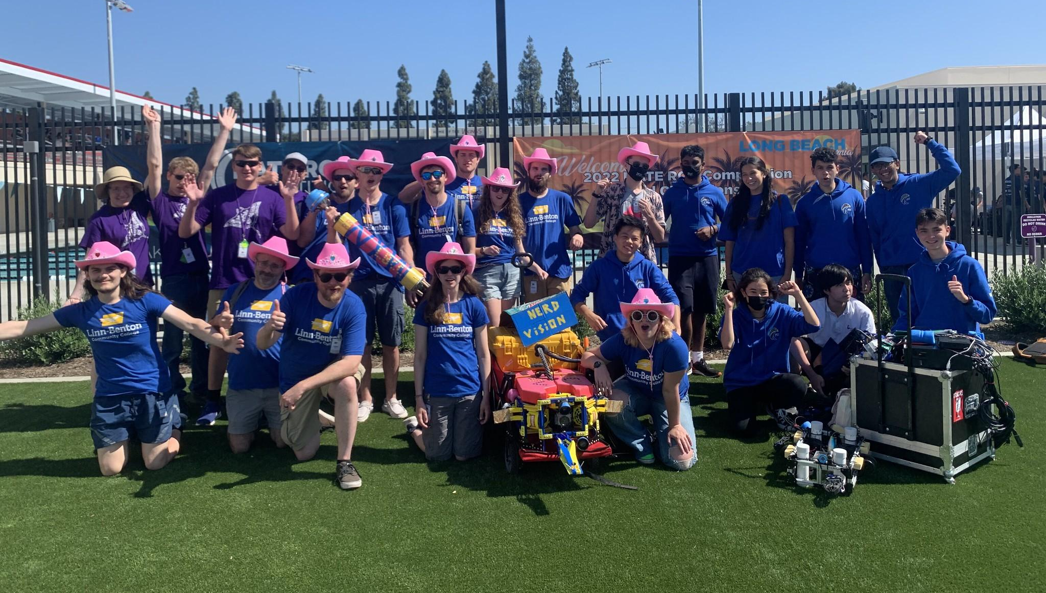
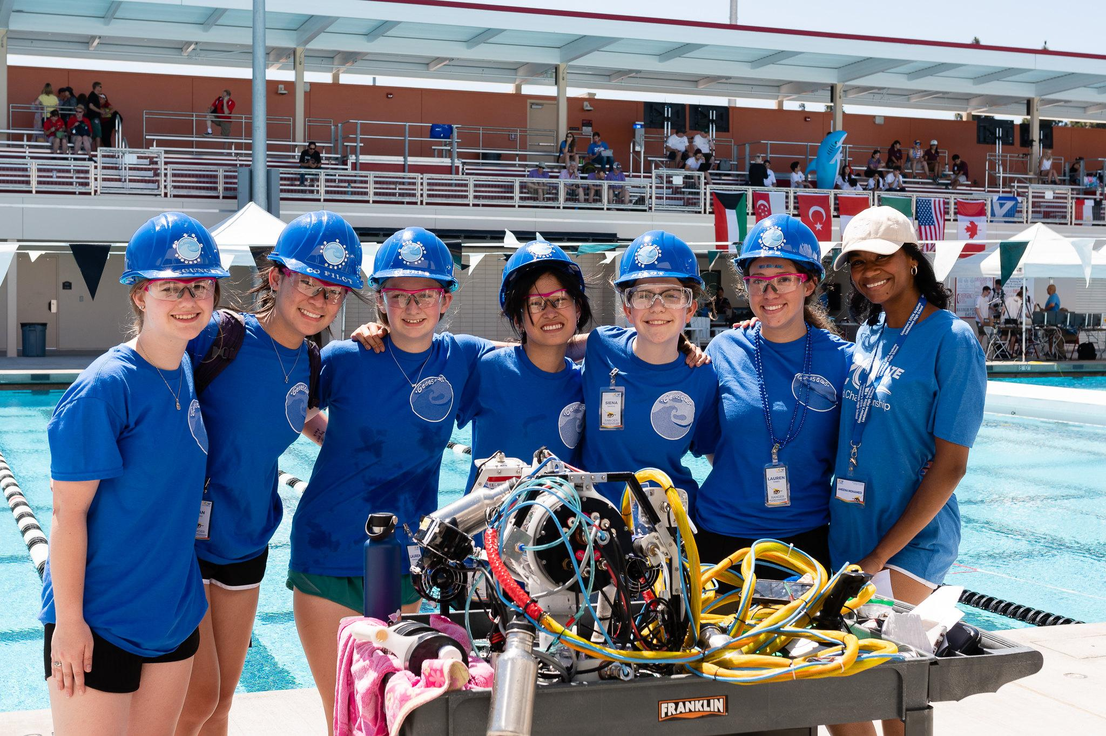
THEN CAME…
MATE Inspiration for Innovation (MATE II)
501(c)3 non-profit incorporated in the state of California in 2016.
Founded to support and sustain ongoing education activities initiated at the MATE Center, including the MATE ROV Competition.
MATE II assumed management of the competition, the SeaMATE store, and related operations on January 1, 2021.

Slide 5
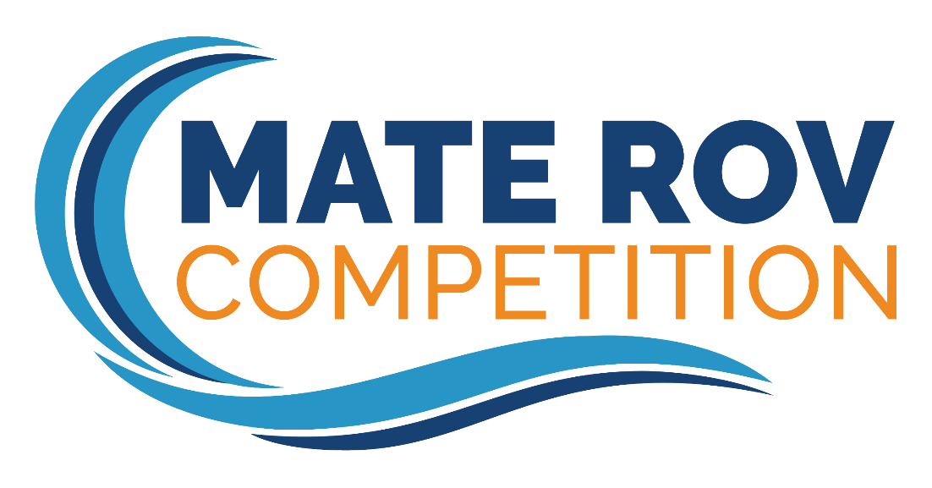
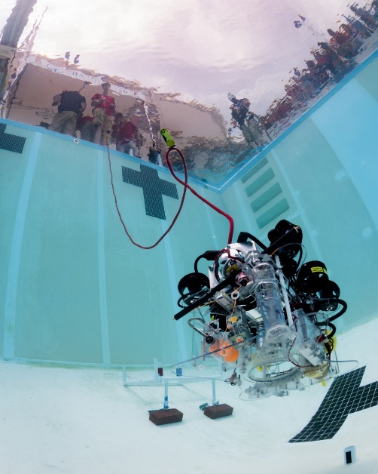
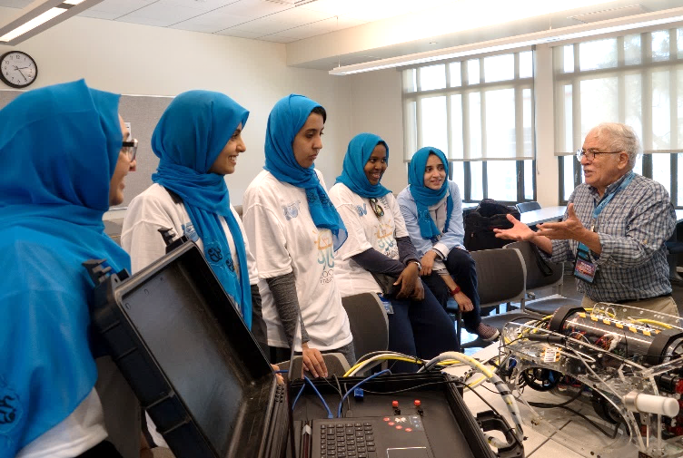
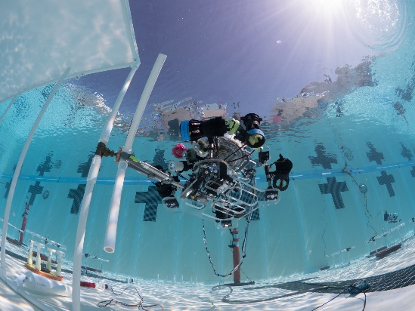
#watergame
What is the MATE ROV Competition?
Global underwater robotics competition that challenges students to tackle tasks based on the real world
Created in 2001 in partnership with the Marine Technology Society ROV Committee
Reach more students and get them interested in the maritime industry
Help students to develop the skills needed to support and sustain marine activities
A program that includes professional development workshops, student outreach activities, instructional materials, starter ROV kits & building guides, and more to support student learning

Slide 6
IT STARTED WITH A PILOT REGIONAL IN 2001 AND TO DATE…
Has involved well over 20,000 students in grades 3-16 who work in teams to tackle missions based on the ocean STEM workplace
Includes one World Championship and a network of 46 (and growing!) regional contests
Involves 100s of working professionals and organizations
Includes underwater missions and technical reports, engineering presentations, and poster displays + more!
Gets students excited about STEM and motivates them to problem-solve, think critically, manage a project, and work together as a team
Is encouraging students to pursue STEM degrees and jobs in the field (see https://files.materovcompetition.org/images/infographics/2020MATEInfographicWEB.pdf for a summary of results from our latest competition “alumni” survey)
Was featured in a book, documentary, and Hollywood movie (Spare Parts)
Notes:
6

Slide 7
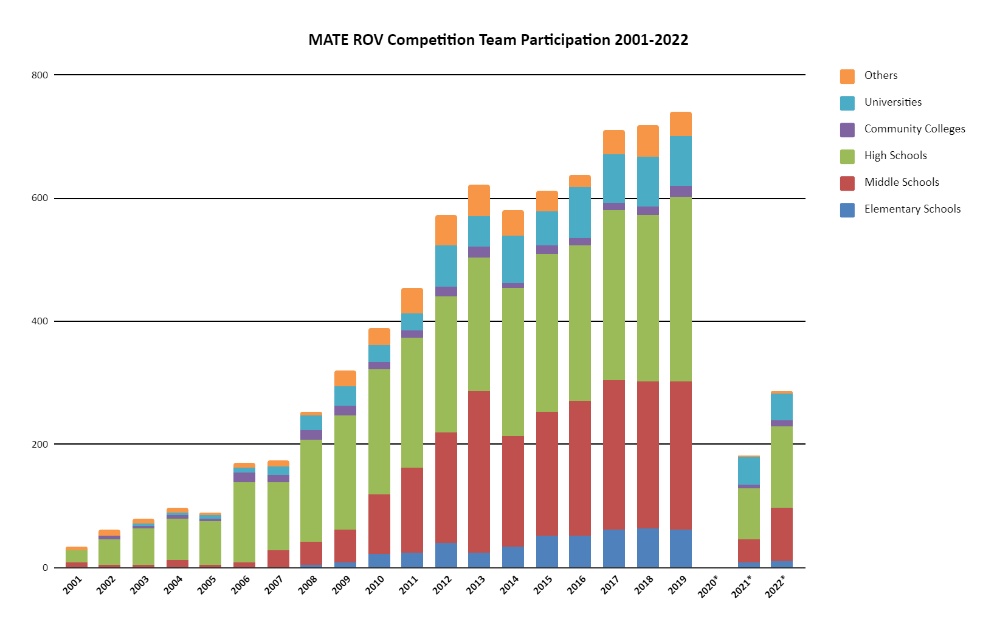
COMPETITION REACH

Slide 8
MATE Global Competition Network
Monterey Bay
The MATE Regional Competition Network began in 2001 and currently consists of 46 regional events that take place across the U.S. and around the world.

Slide 9
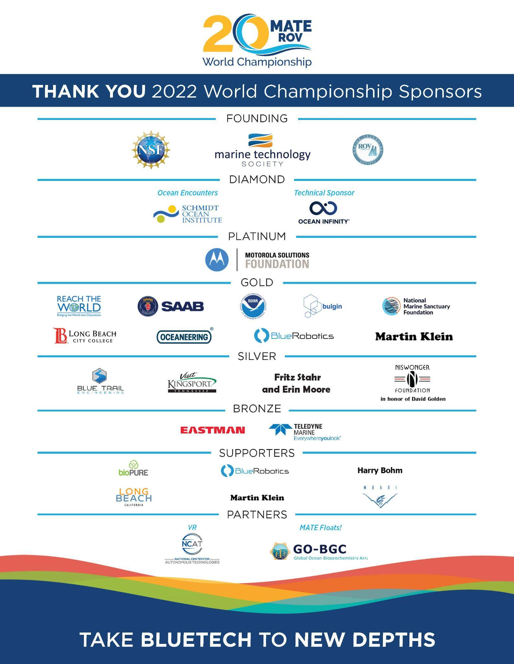

Slide 10
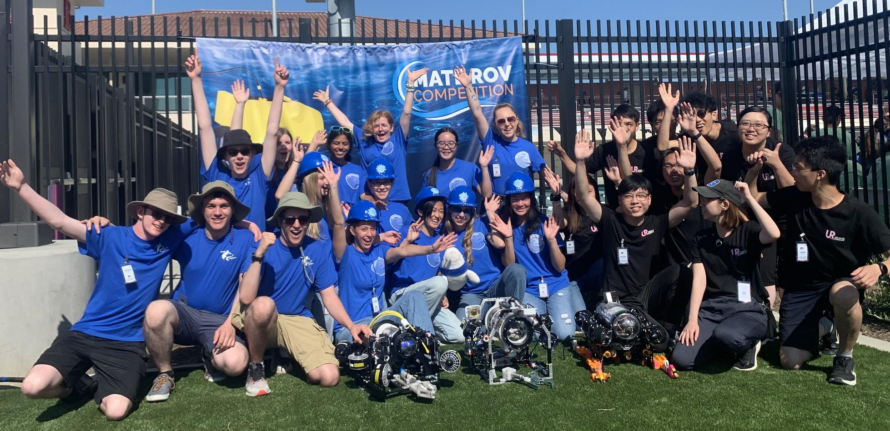
#watergame
“Think of yourselves as entrepreneurs”
Entrepreneurial, business-oriented approach where students transform their teams into companies that design, build, & market their products and services
Theme and underwater mission tasks change each year and are presented to the students in the form of an RFP
2011 – Deepwater Horizon
2017 – port and harbor security centered on the Port of Long Beach
2021 – remediating plastic pollution, studying the impact of climate change on coral reefs, and maintaining healthy waterways
(all simulated in the bottom of a swimming pool or test tank)

Slide 11
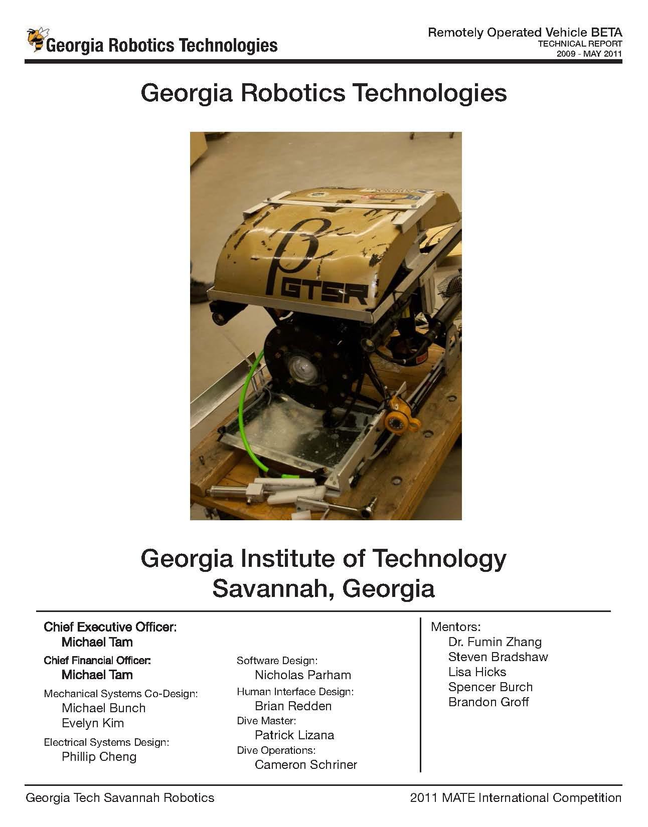
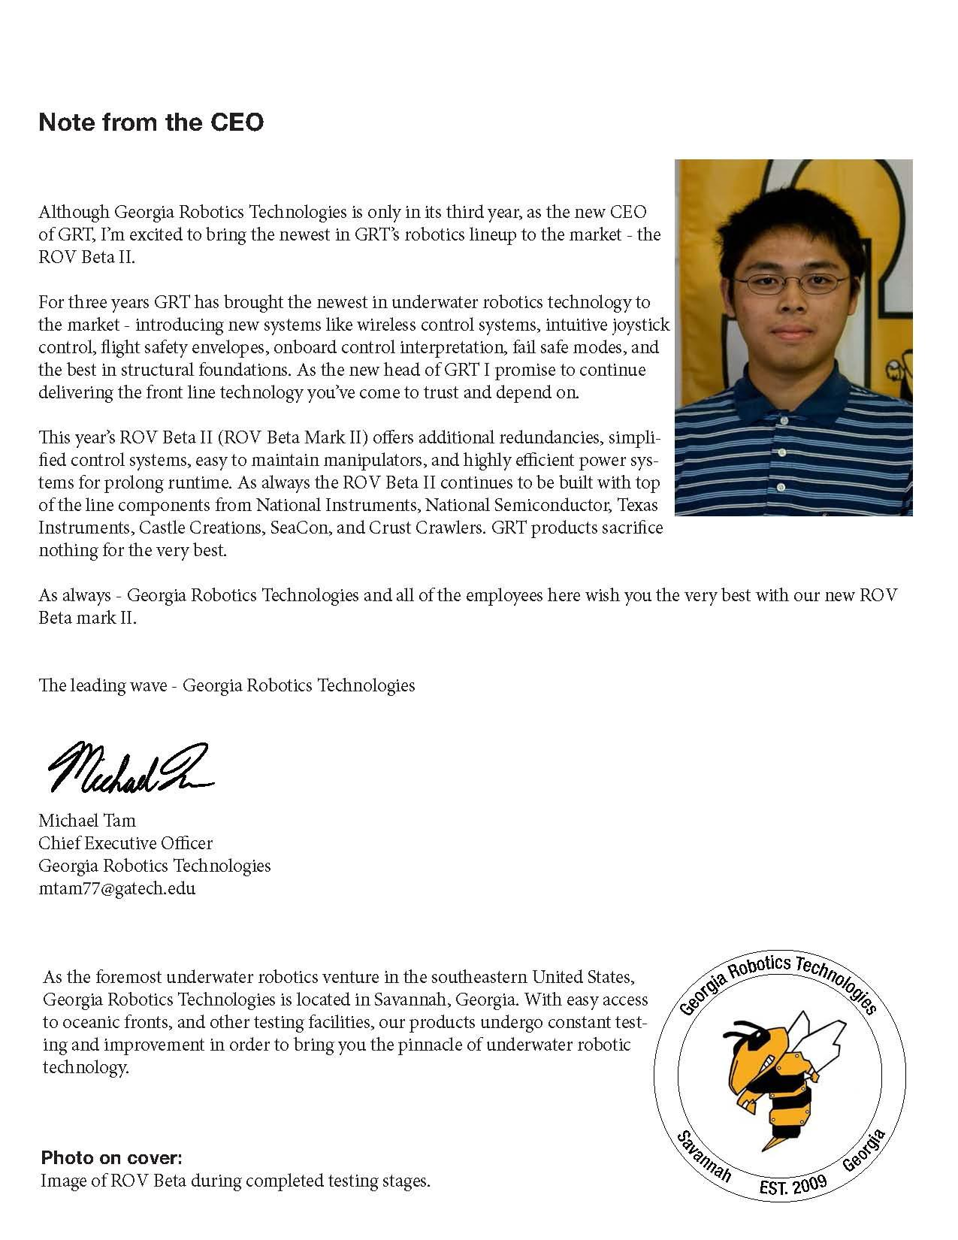
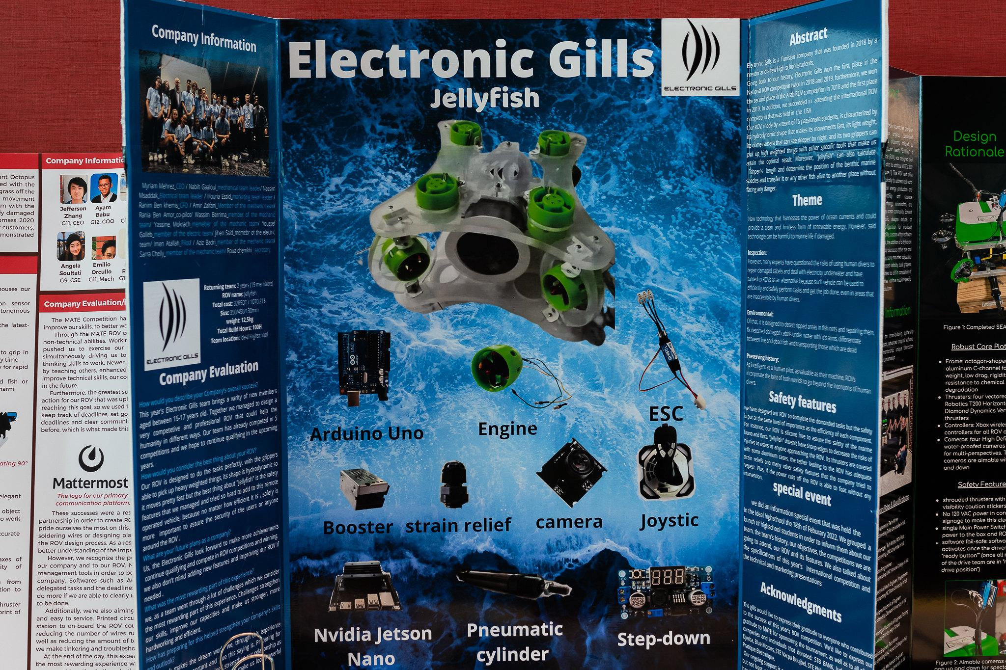
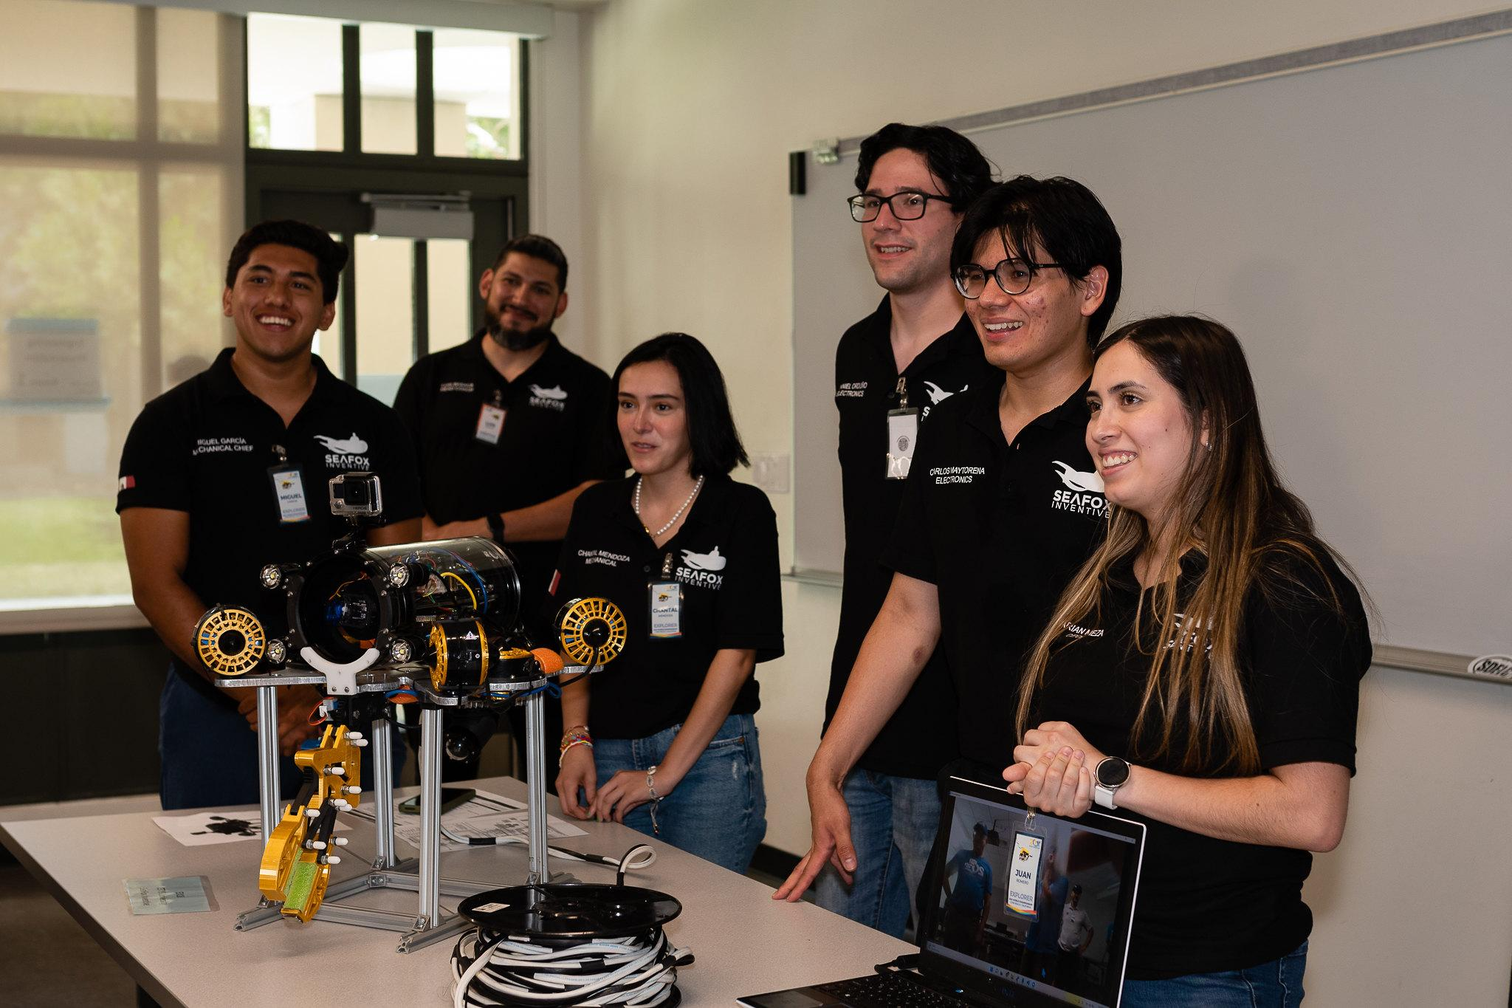
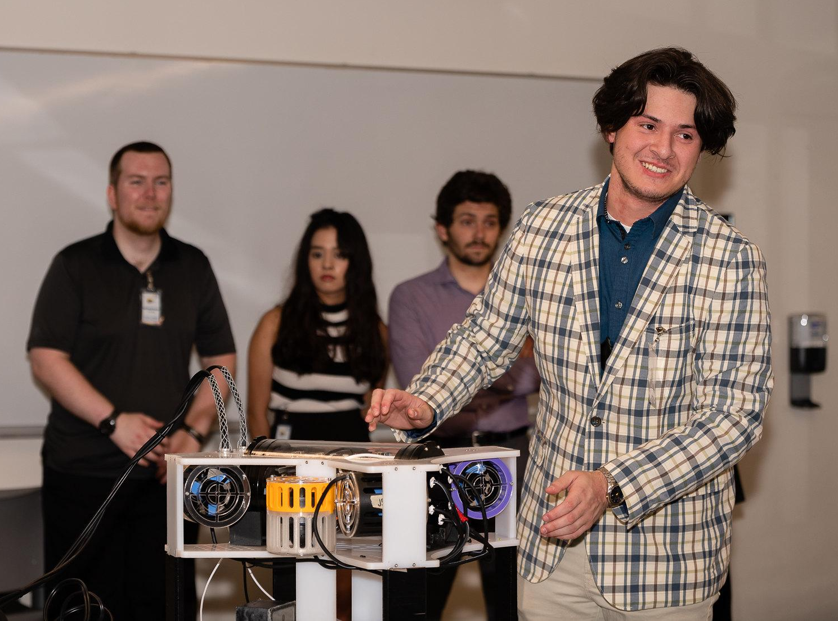
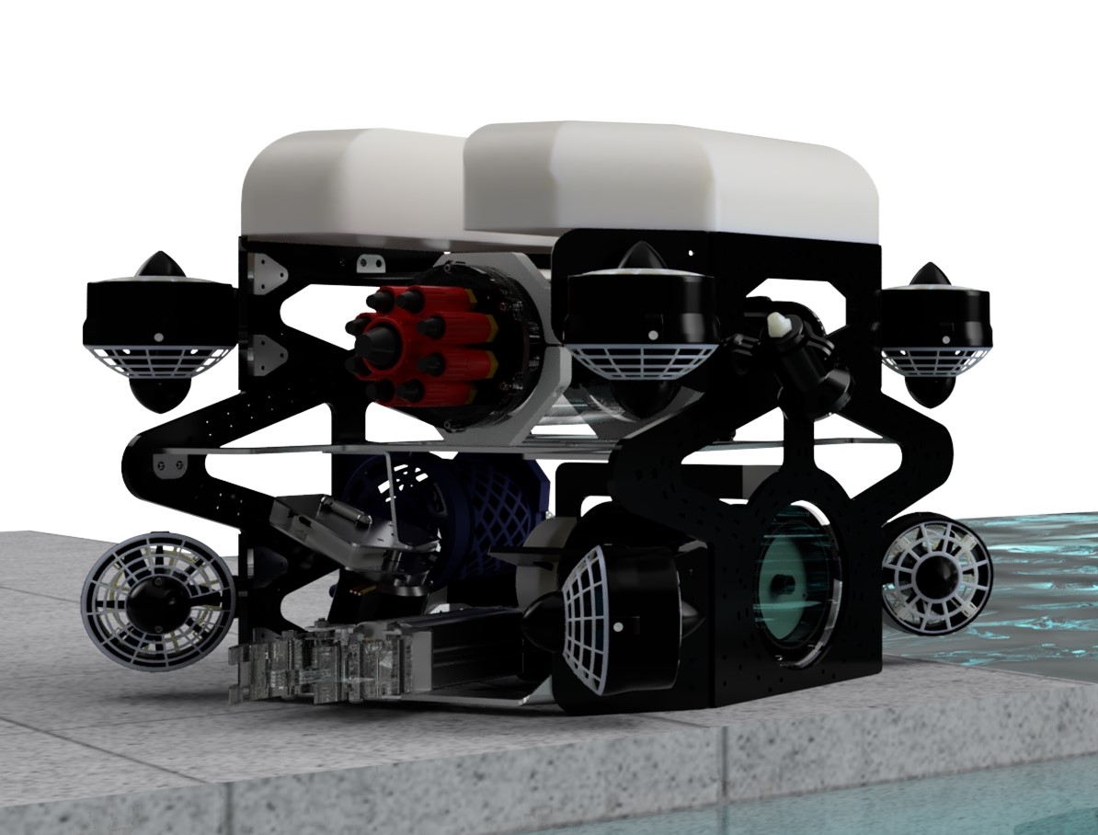
Engineering & Communication
Technical Documentation & Company Spec Sheets
Engineering (oral) Presentations
Marketing Displays
Corporate Responsibility
SAFETY
VR Assets (logos, photos, CAD drawings)

Slide 12
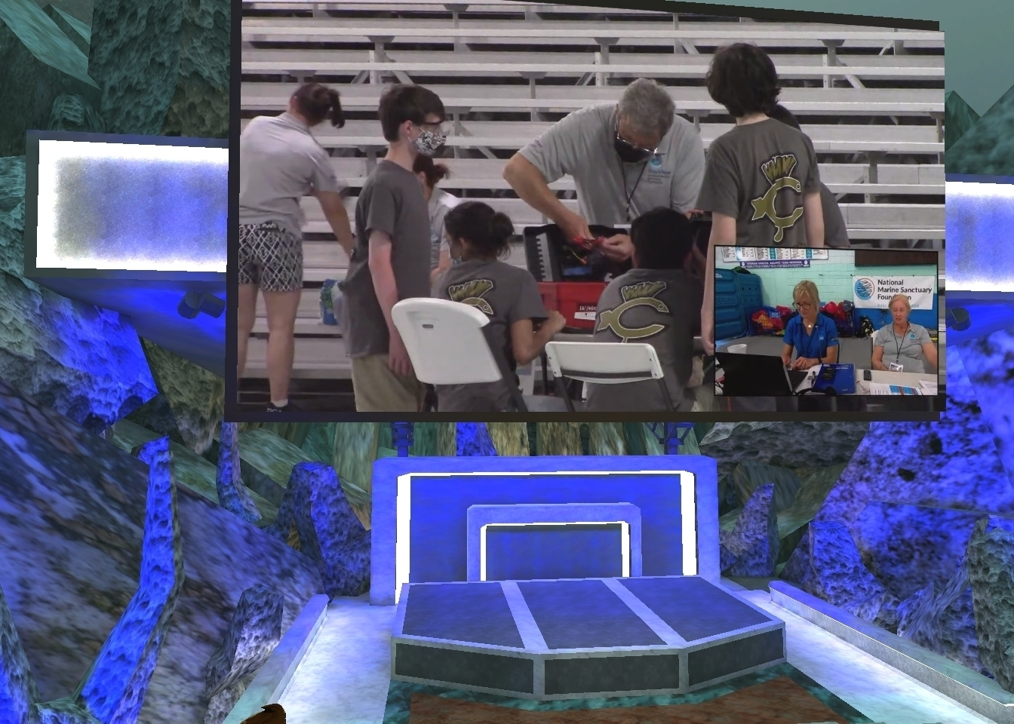
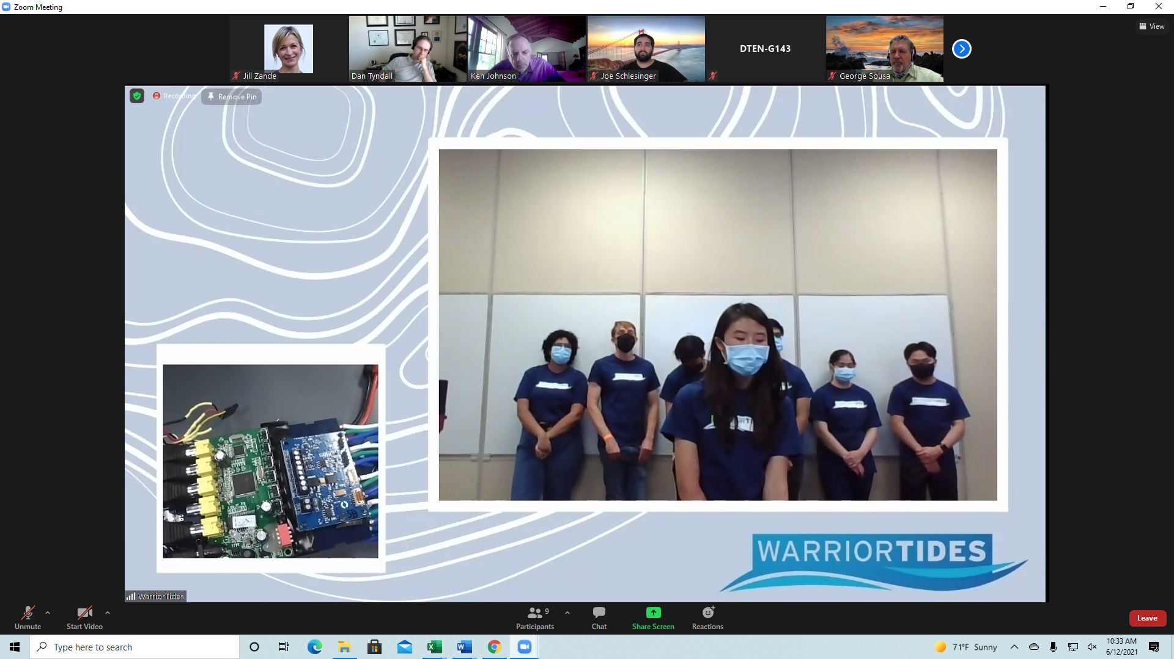
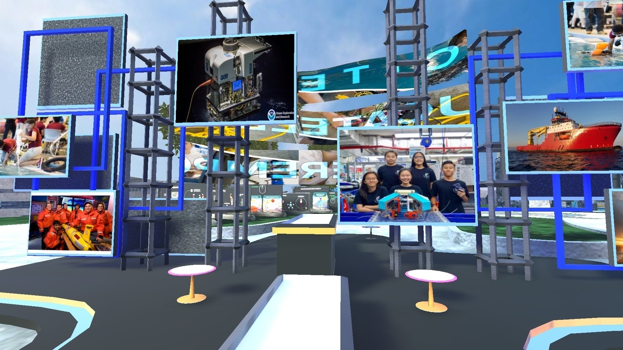
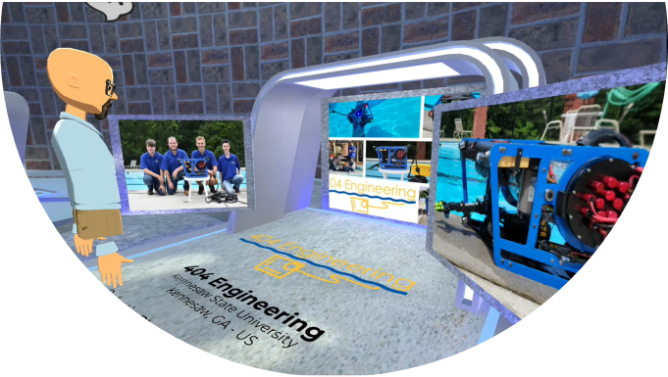
COVID-inspired pivots that will persist beyond the pandemic
MATE ROV Competition VR World for Social Engagement
Facilitate the social interaction, peer-to-peer networking, and “shared experience” that students value and appreciate about the MATE ROV Competition.
Enable students and mentors to experience the event even if they can’t participate in person.
Two overarching competition categories:
IN-PERSON (for those teams that qualify and can/are willing to travel to the event)
TELEPRESENCE: Remotely Connecting To Your Competition Experience (for those teams that are not able to attend in person for whatever reason - financial, travel restrictions, concerns for COVID, etc.)

Slide 13
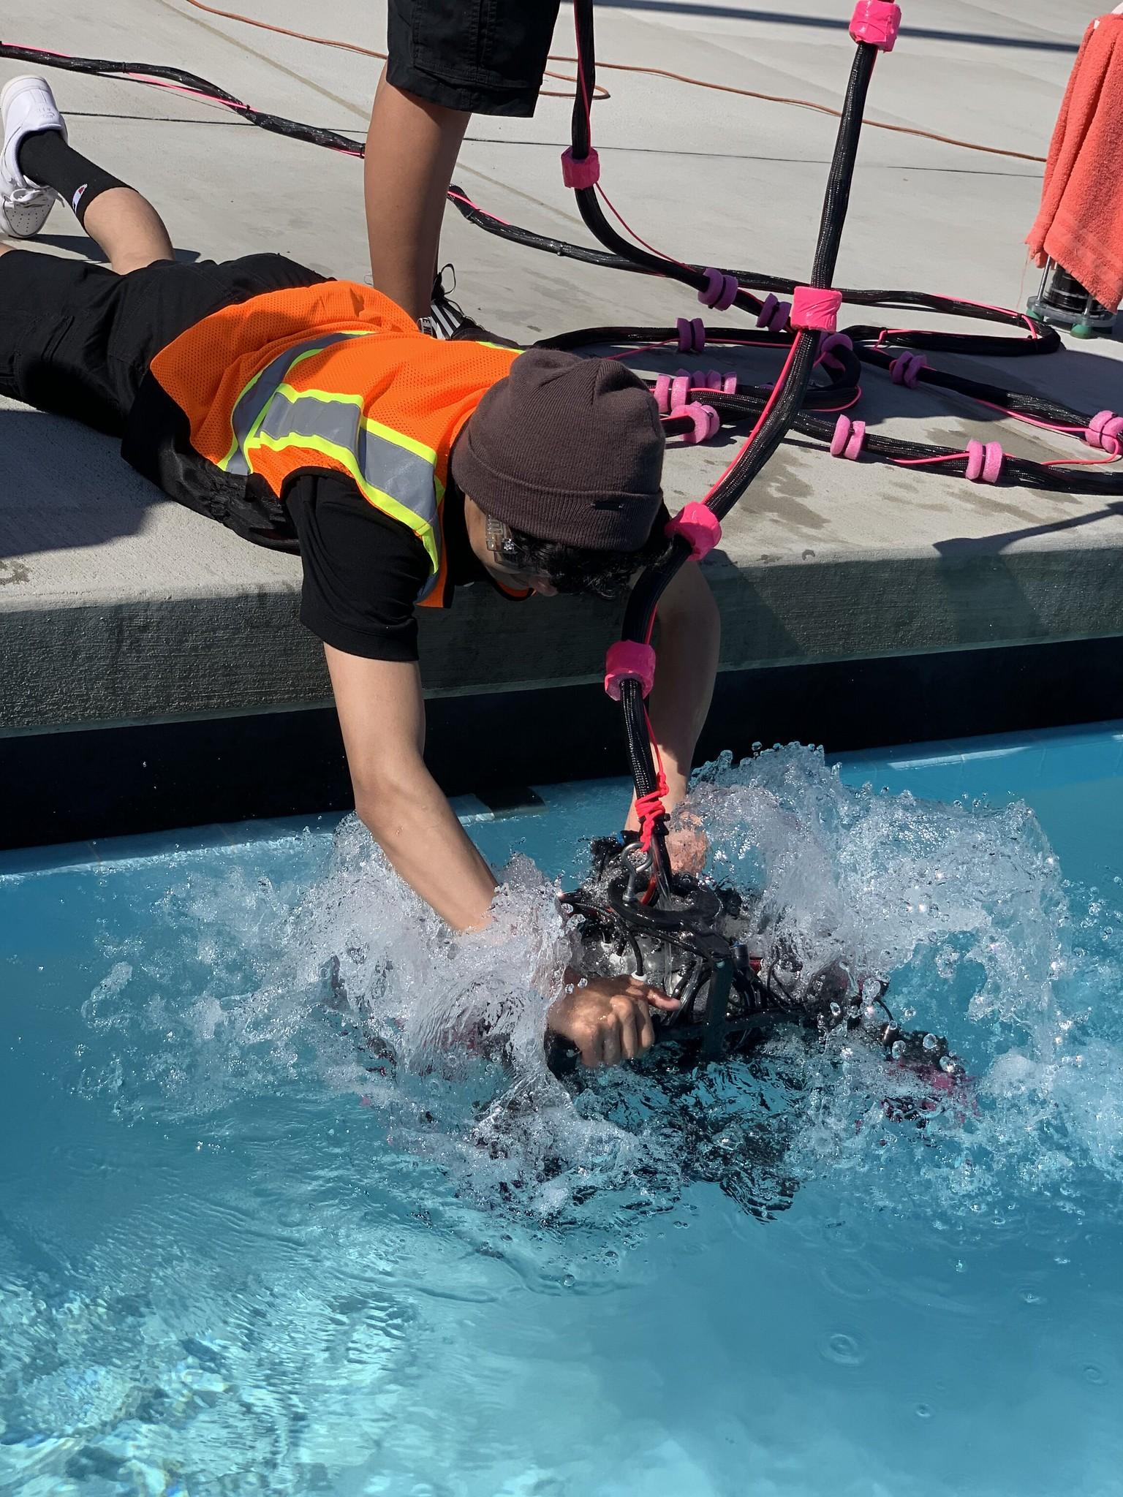
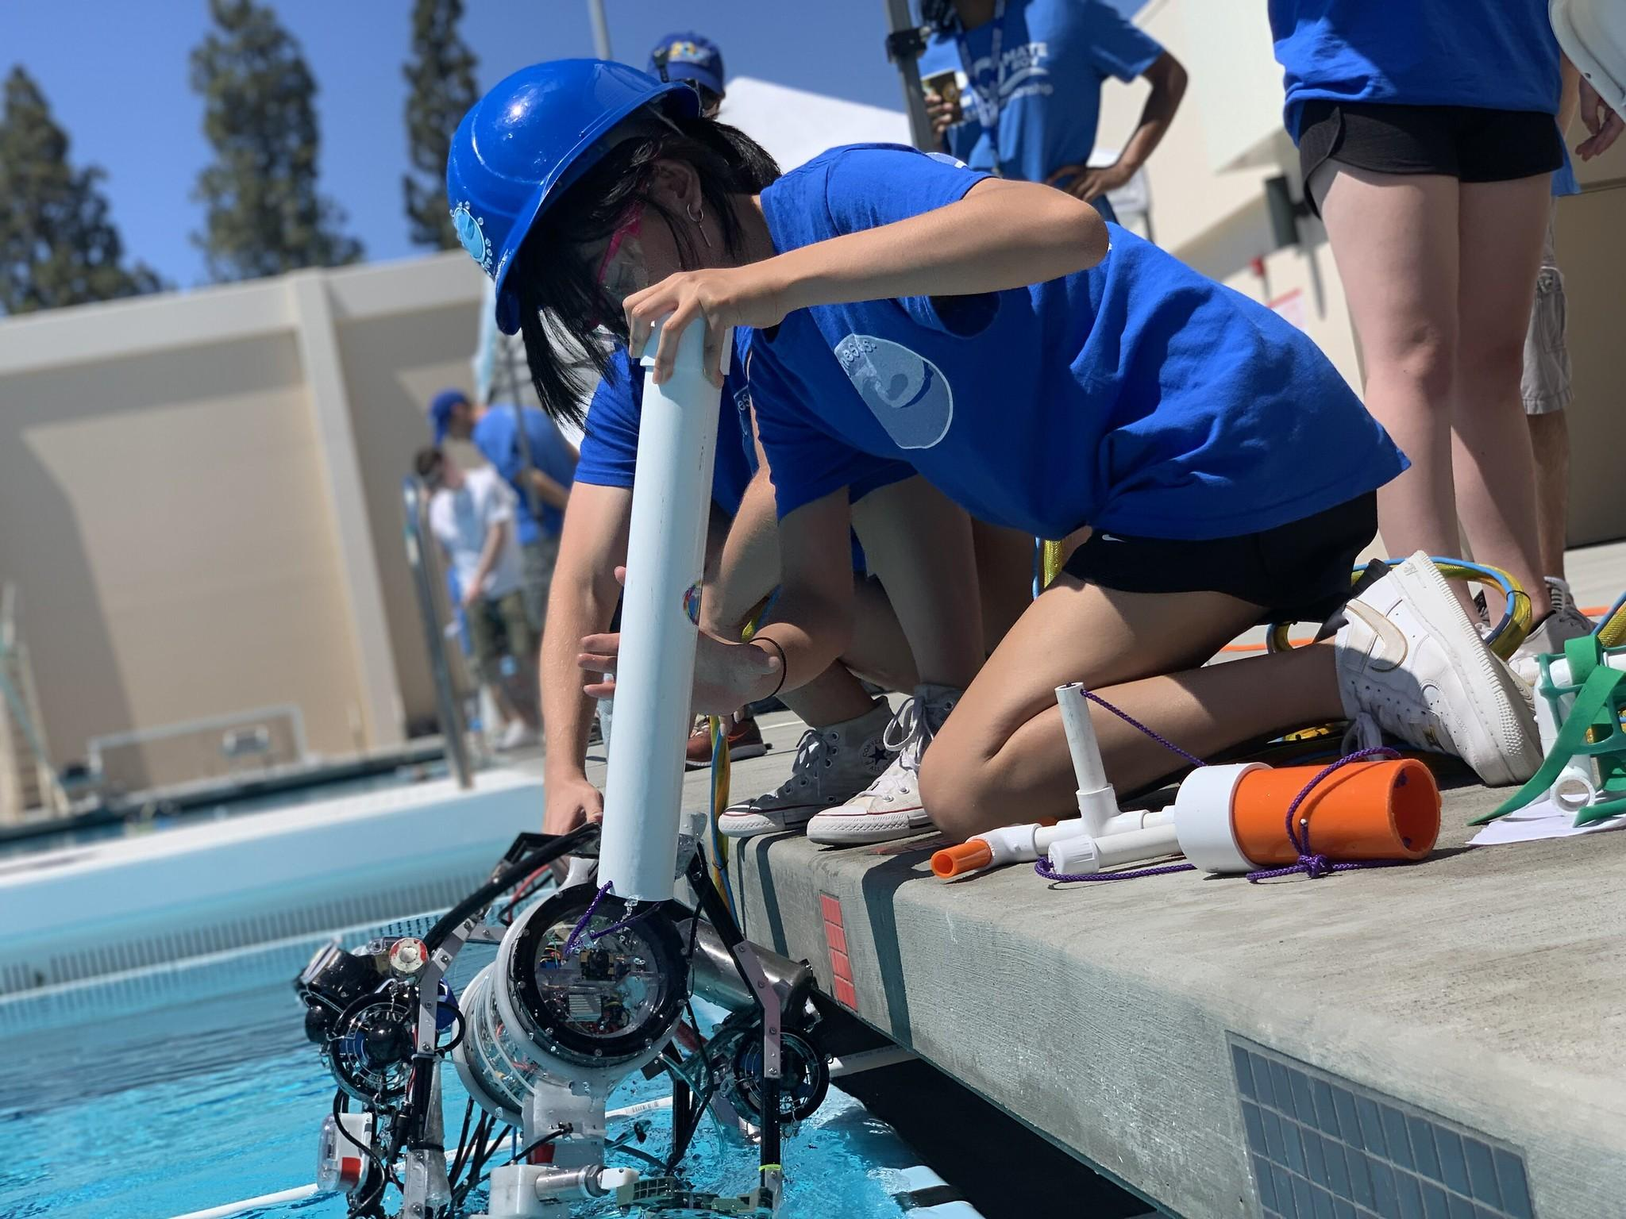
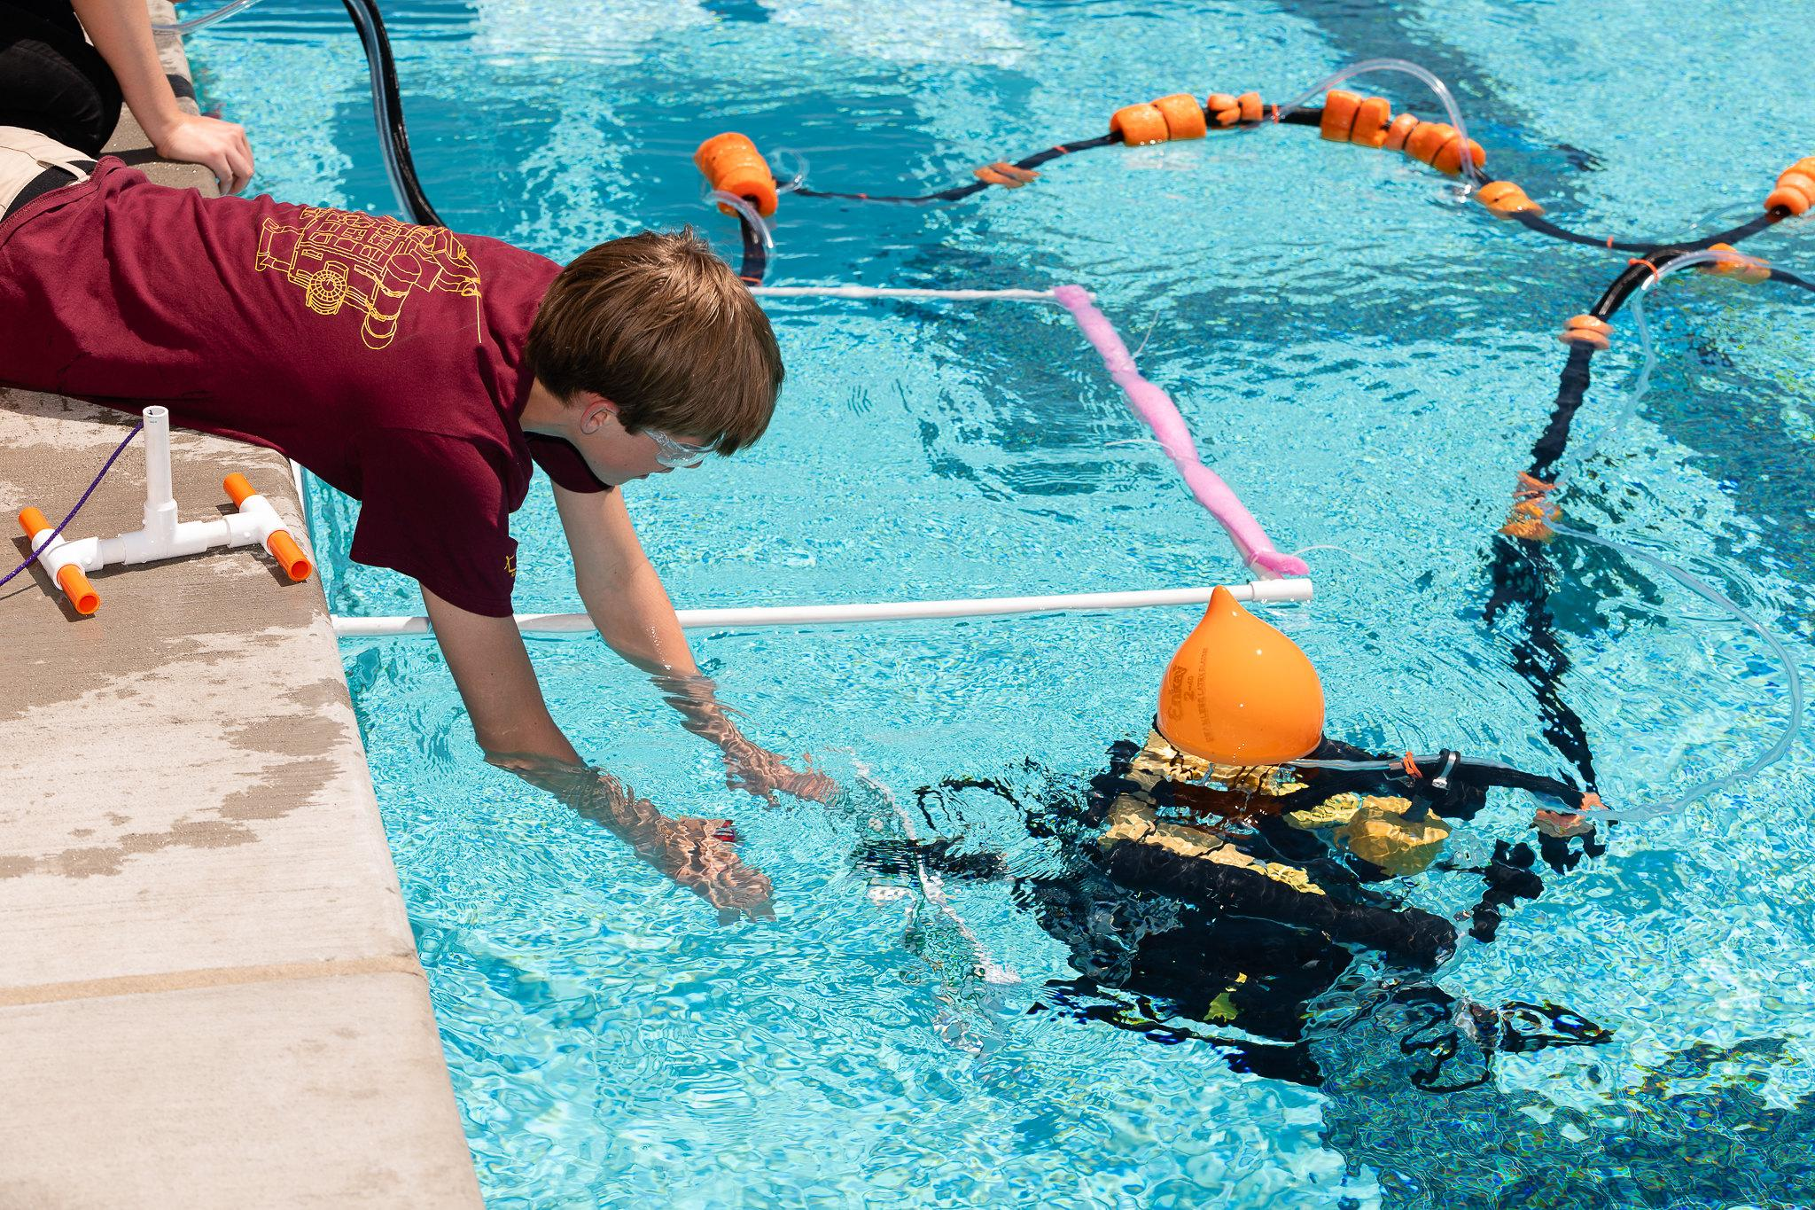
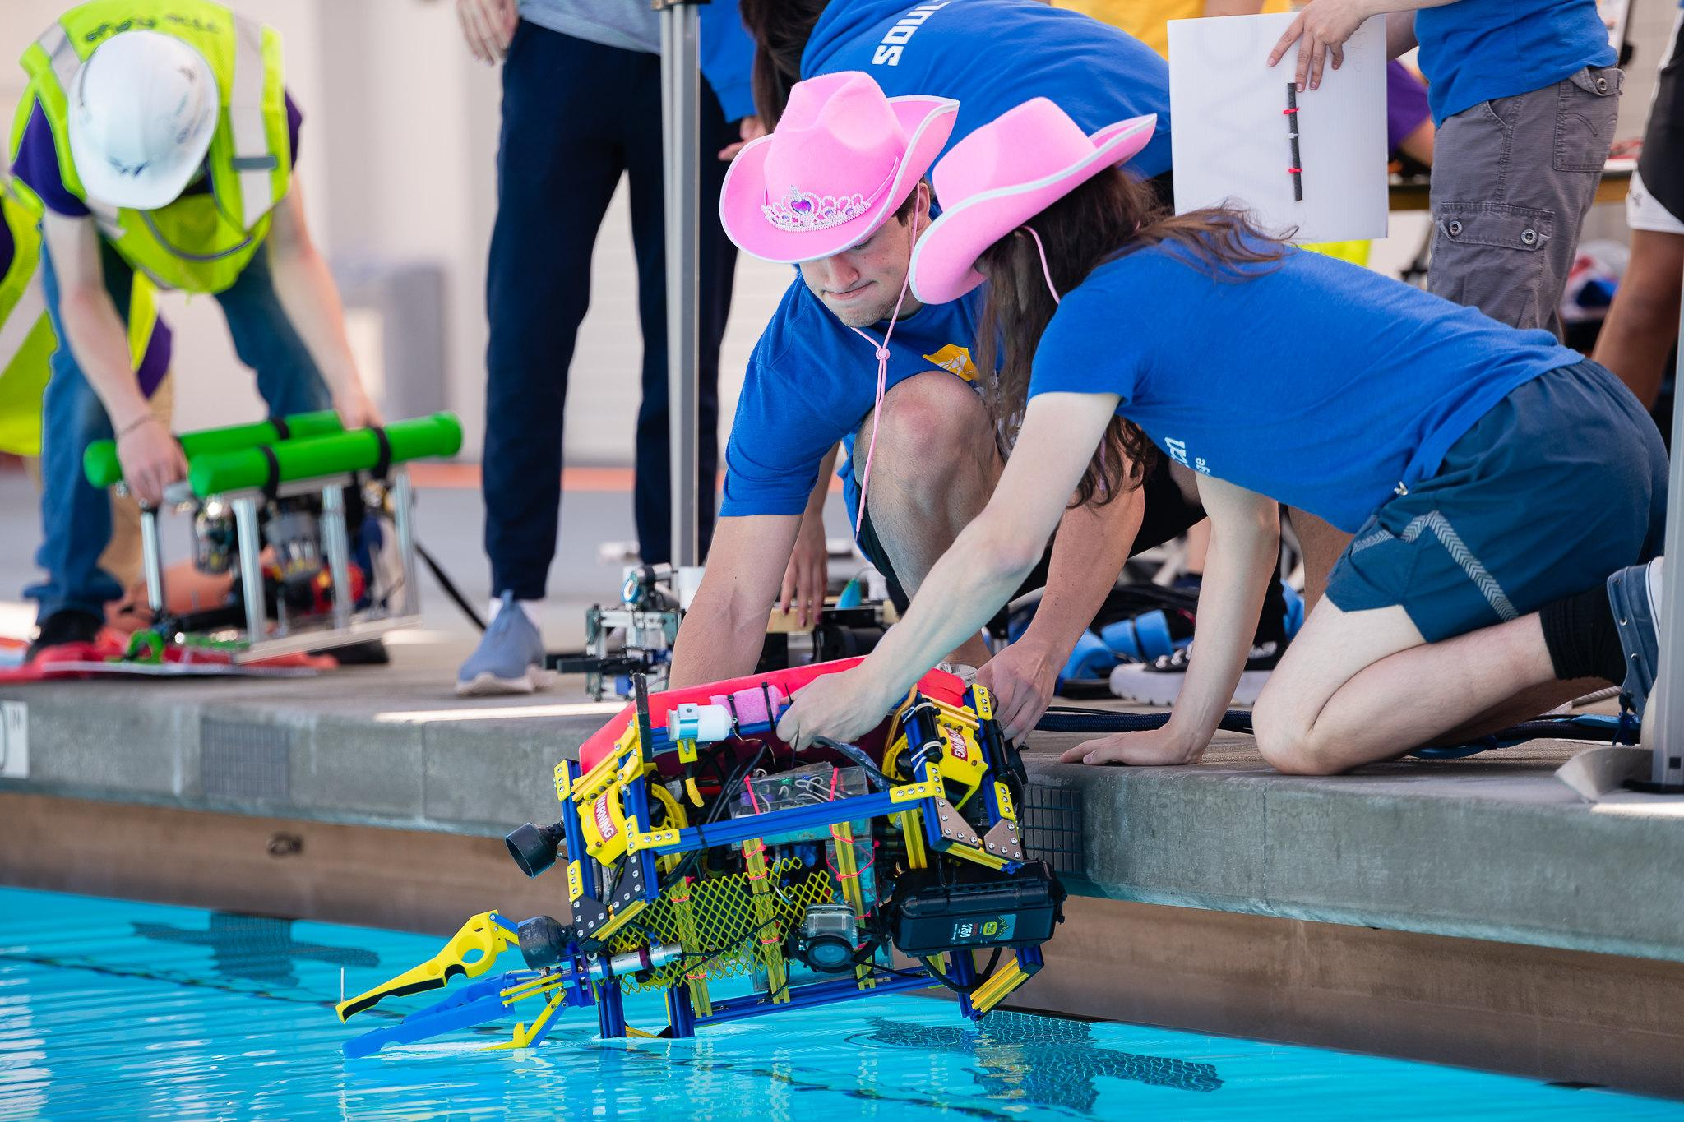
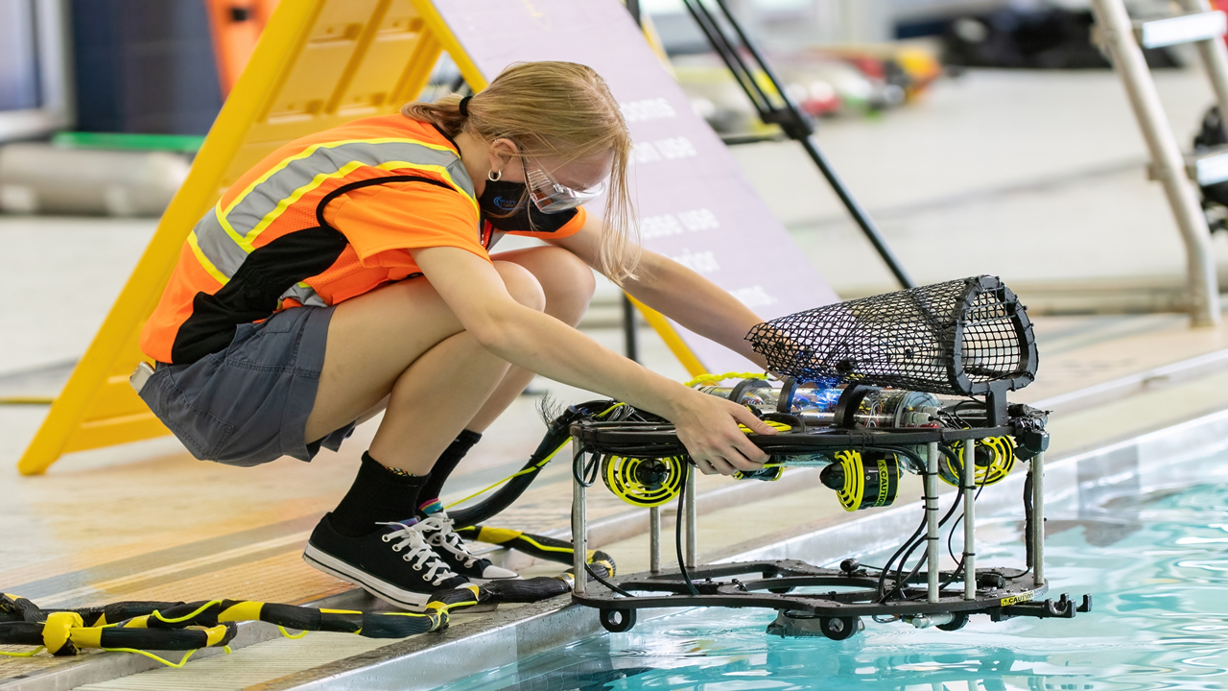
PROGRESSION OF LEARNING
The competition is divided into 5 classes that vary depending on the vehicle specifications and complexity of the mission tasks:
SCOUT (beginner)
NAVIGATOR (beginner/intermediate)
RANGER (intermediate)
PIONEER (intermediate/advanced - new in 2022!!!)
EXPLORER (advanced)
This progression complements the educational pipeline and encourages students to stay engaged and advance to the next class after they master their current level.

Slide 14
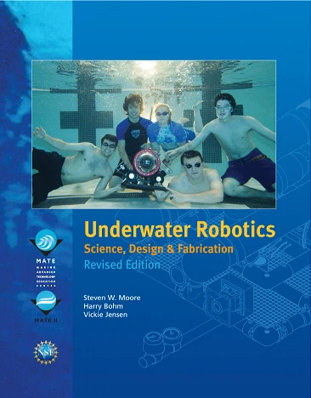
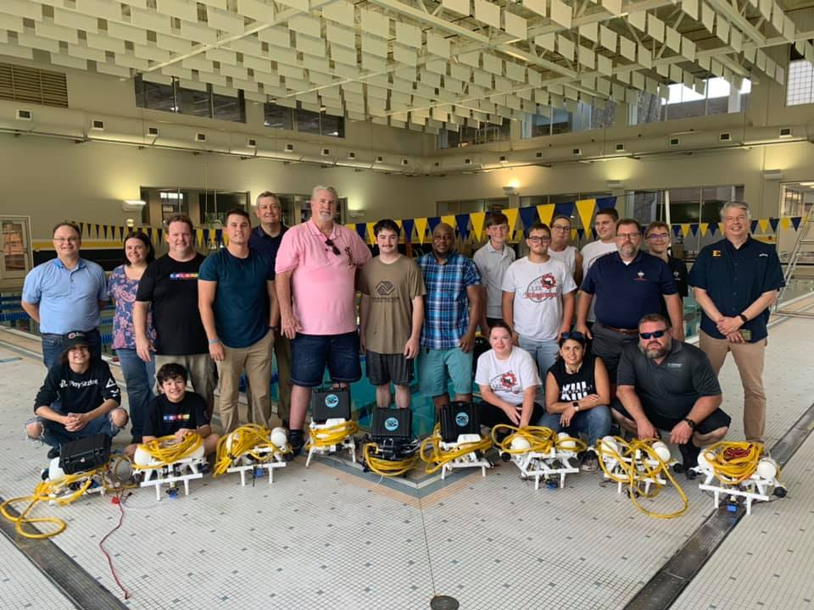
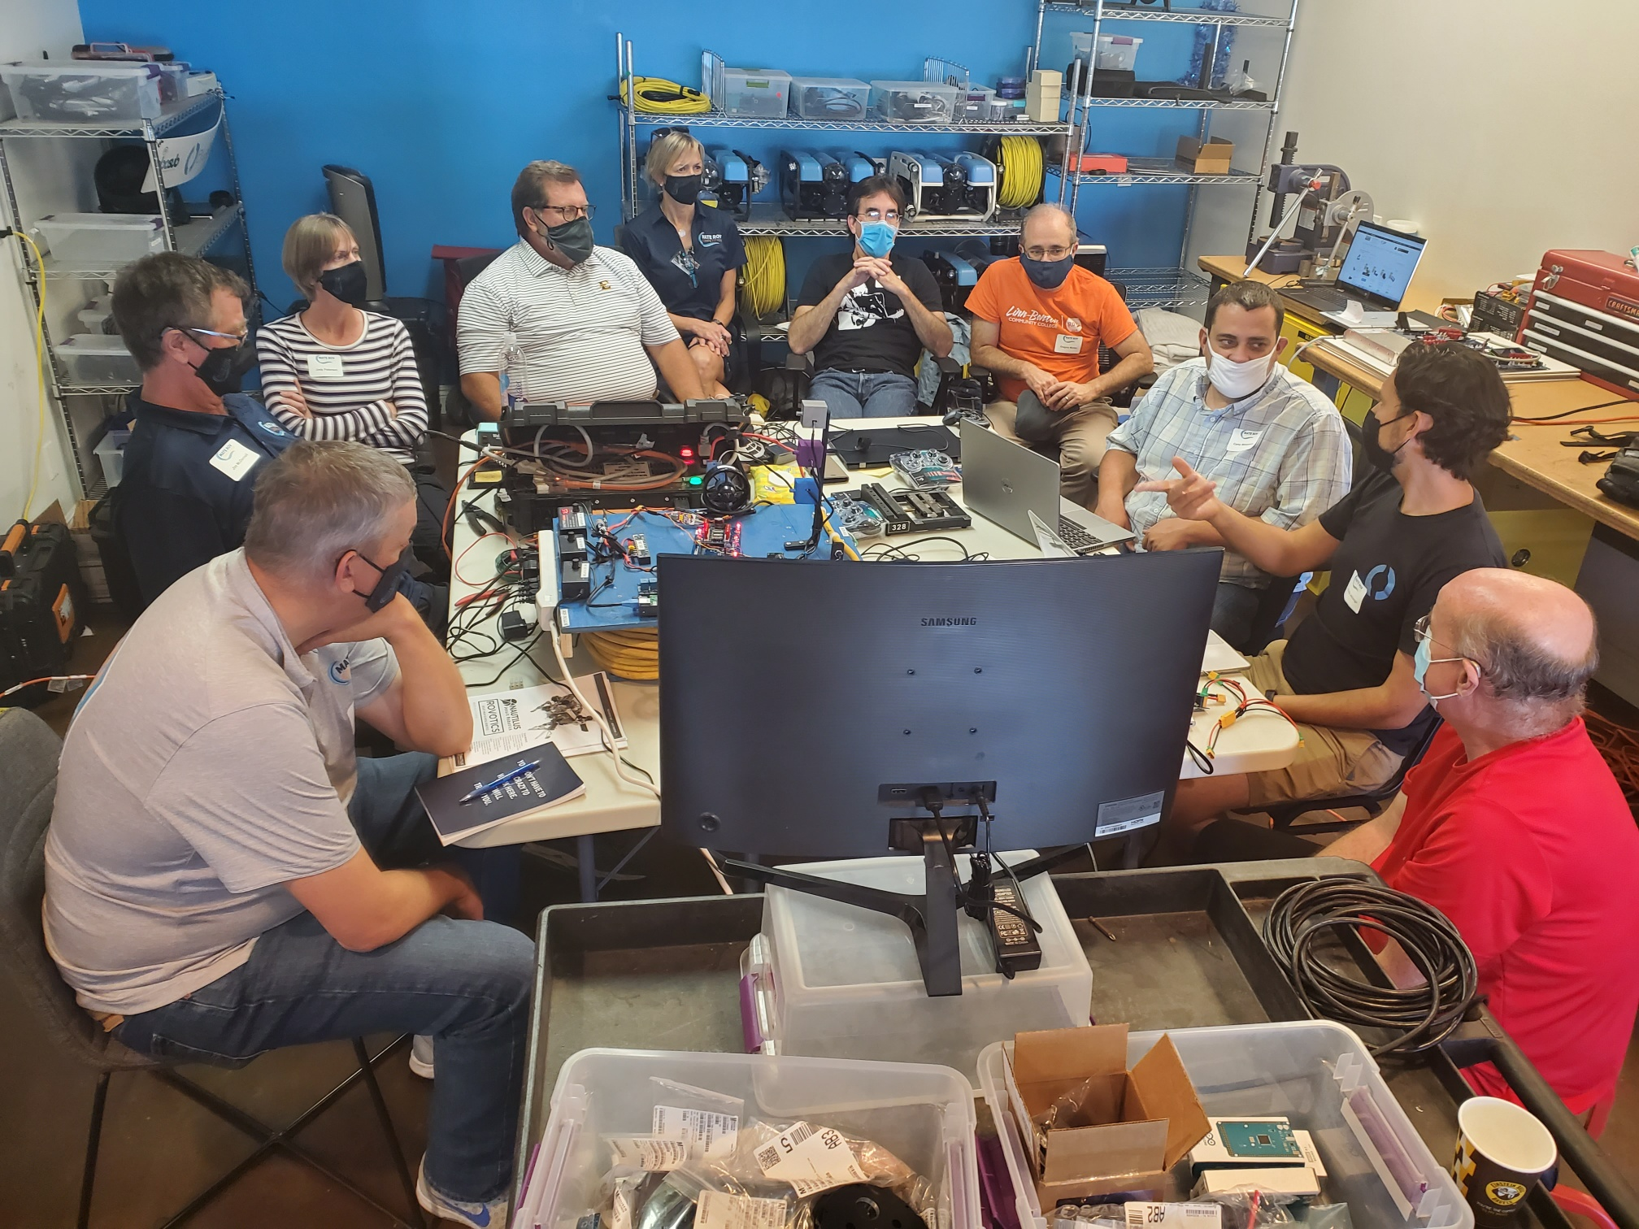
SUPPORT FOR TEAM DEVELOPMENT
Professional development workshops for teachers
Student outreach and skill building workshops
SeaMATE starter ROV kits SeaMATE Store @ seamate.org
Instructional materials that are tied to educational standards and promote student learning MATE Educate @ educate.materovcompetition.org
Underwater Robotics: Science, Design & Fabrication

Slide 15
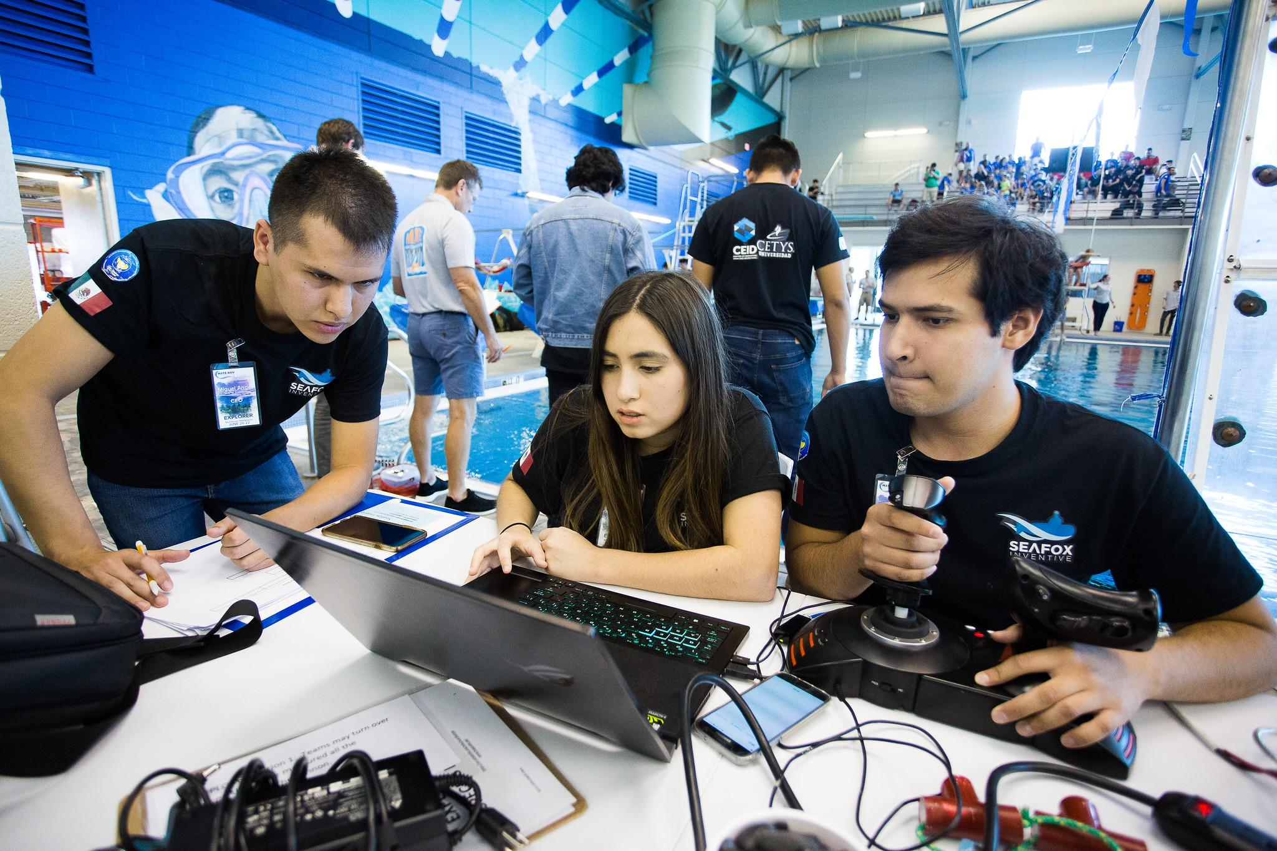
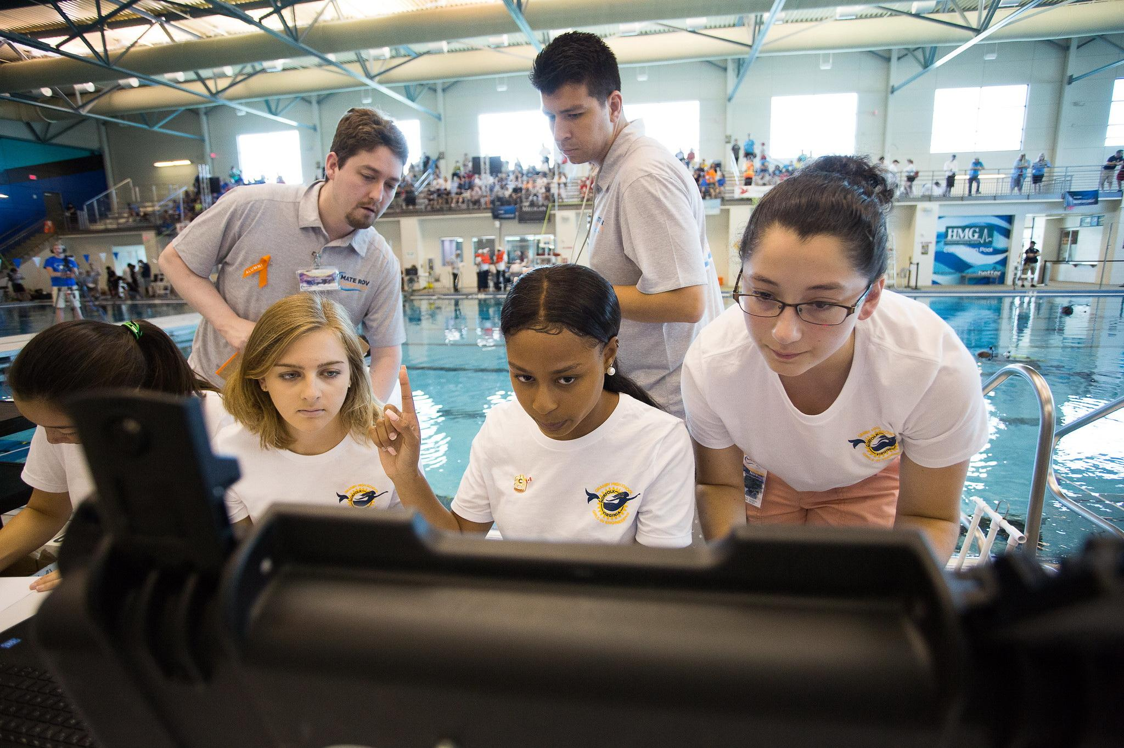
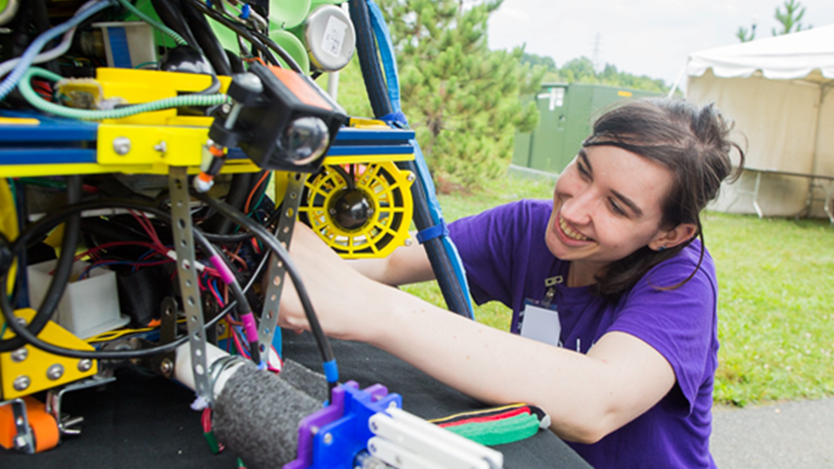
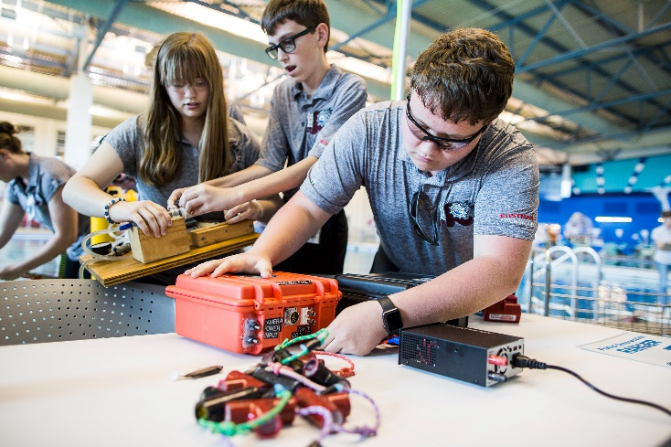
TIMELINE/DURATION
Mission briefing that announces the theme and includes the background scenario, bulleted list of mission tasks, and details on a preview task is released in September
Competition manuals that detail all of the mission tasks and include design and building specifications and prop building instructions are released in November
Registration opens December 1st
Regional contests take place in April and May
World Championship is held in June (location and date TBD)

Slide 16
2022 CHALLENGES
UN Decade of the Ocean: MATE Inspires ESG
June 23 - 25, 2022
Long Beach City College
Long Beach, CA
2023…

Slide 17
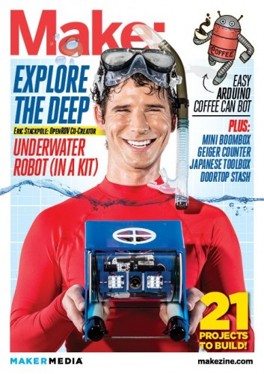
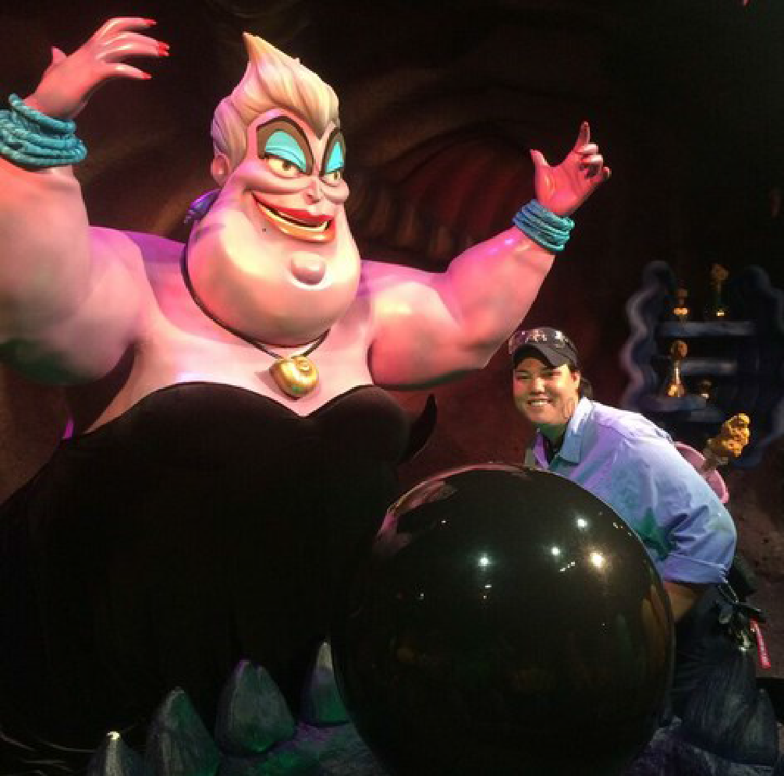
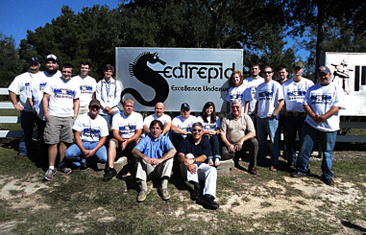
RETURN ON INVESTMENTS
Students have…
Used the MATE competition as the focus of college entrance essays
Been awarded scholarships or internships as a result of their participation in the ROV competition
Gone on to work at research facilities like WHOI and MBARI
Been hired by Oceaneering International, Schilling Robotics, General Motors, Virgin Voyages, NASA, Disney, and more!
Started their own companies (OpenROV)
See more examples at www.materov20.org/stories

Slide 18
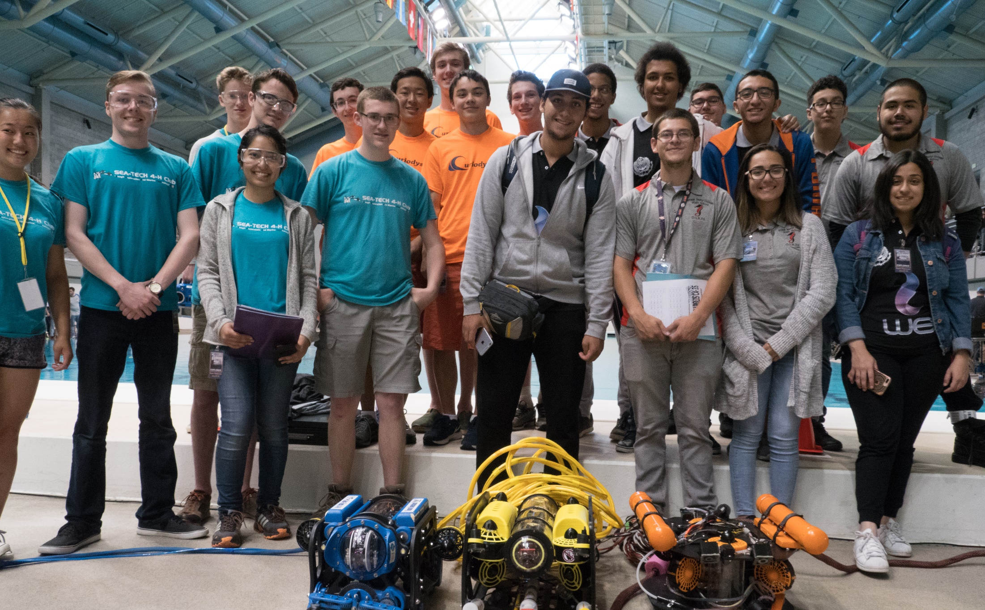
Creating a global community of learners who can think critically, solve problems, be creative and resourceful, and work as team to address societal challenges – and who can succeed in today’s constantly evolving workplace.
EXCITE EDUCATE EMPOWER

Slide 19
“THE ASK:”
MATE Inspiration for Innovation is a 501(c)3 non-profit (EIN# 81-4389131)
Office space (1,000-1,250 sq. ft.)
Funds $$$
Dollars that can be used for scholarships for new teams and to support activities and events like professional development workshops and competitions in Monterey and the MATE World Championship
People
Volunteers to serve as judges and technical support at competition events, mentor teams, and spread the word about the program
New customers
With the holidays around the corner, consider an underwater robotics kit for your kids, grandkids, friends, and/or neighbors – visit www.seamate.org

